Slide 1
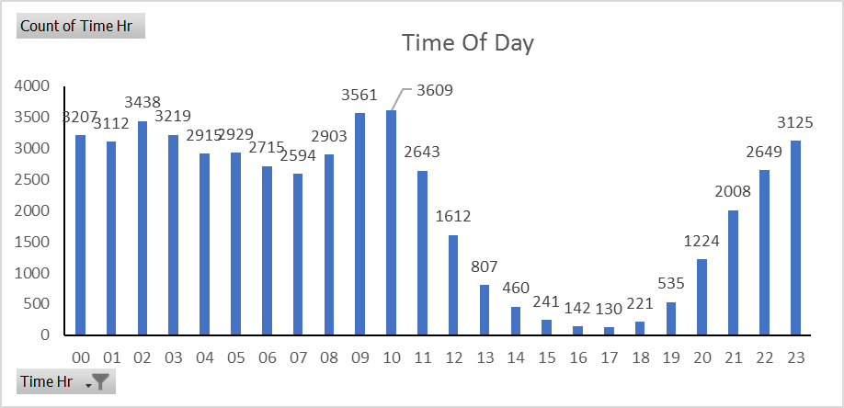
Overview of brand’s sales performance
Overall:
Total Sales: 1,01,332 units &
Total Revenue: 6,699,843.72 AUD
Basket:
Revenue Per order: 66.12 AUD
Attributes:
Time of Day: 22-11 hr. [ In this time period shopping happens more than their average]
Peak Hours: 09 – 10

Slide 2
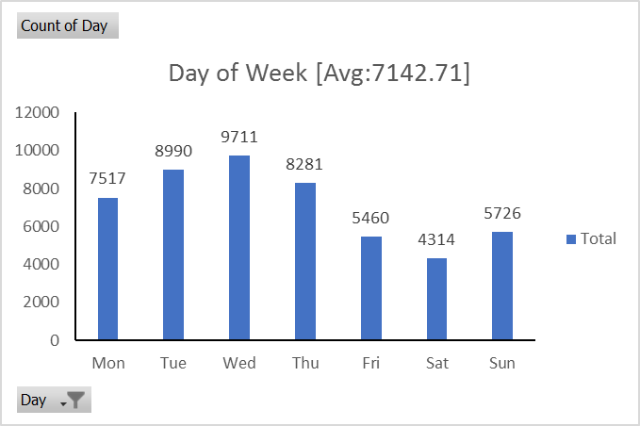
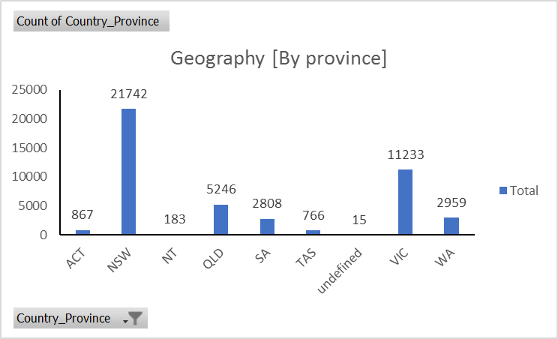
Overview of brand’s sales performance
Day of week: Mon- Thu [ Below average sales in weekend] Peak Day: Wed
Geography: NSW [By province]
Geography: AU [By Country]

Slide 3
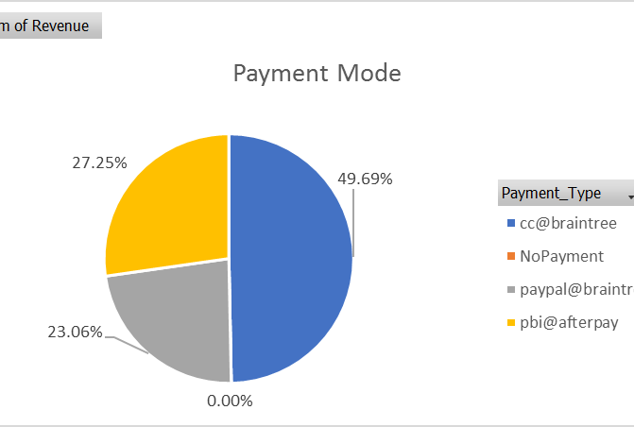
Overview of brand’s sales performance
Payment Type: cc@Braintree [50%]
Very few records doesn’t have payment history
Frequency:
Single Purchasers: 25,517 user
Multiple Purchasers: 24,468 user
Typical Attributes:
People who buy in bulk are very few.

Slide 4
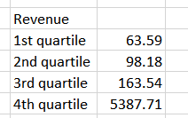
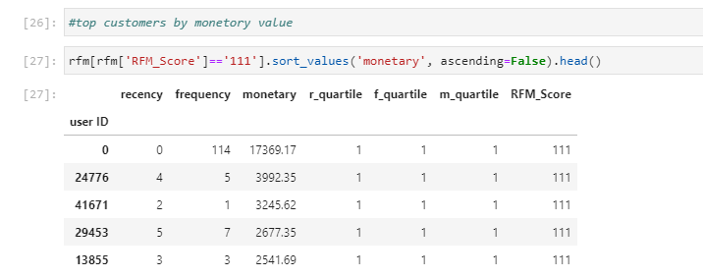
Segmentation
Segmentation of the brand's audience based on Revenue which has 4 distinct groups: 4,3,2,1
Group 1 : Revenue 0- 63.59
Group 2 : Revenue 63.59 – 98.18
Group 3 : Revenue 98.18 – 163.54
Group 4 : Revenue 163.54 – 5387.71
Customers with revenue spending in group 3 can be encouraged to spend more by attracting them with discounts.
Customer in group 2 is at risk they need more frequent discount to stay connected with store
Customer in group 1 is almost lost
Group 4 is our potential customer group

Slide 5
Marketing: Media Strategy
Target more advertising in NZ region as most of the people are not aware of the brand
Make the website SEO friendly
Find cross selling opportunity with potential customers
Identify best selling products and promote them
Have more control on digital spend and try to focus on lead generation
Store may start to put up social media stories with proper hashtag for more reach
By looking at peak season/hour production/staff planning should be done
There are multiple retail in house software (e.g., footfall device, geo-fence) available which used for effective marketing and real time analytics report

